Slide 1

Part 1.
JDBC

Slide 2
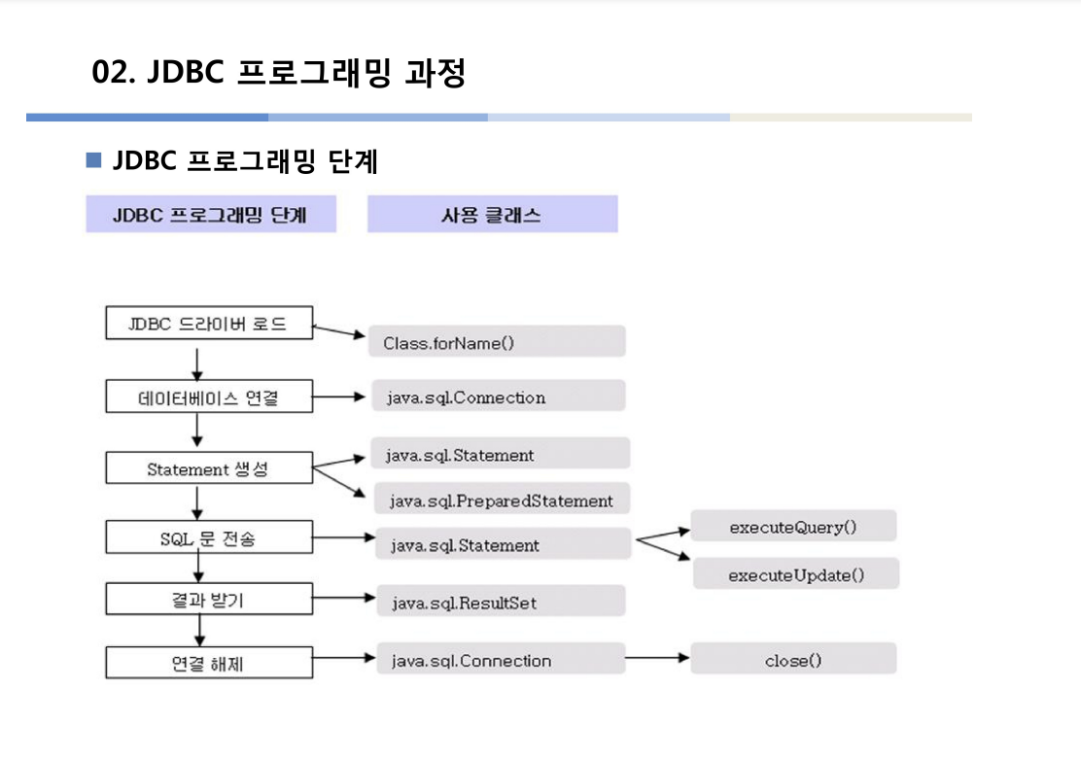
chaper 18
01
Cnnector/J 다운로드/설정

Slide 3
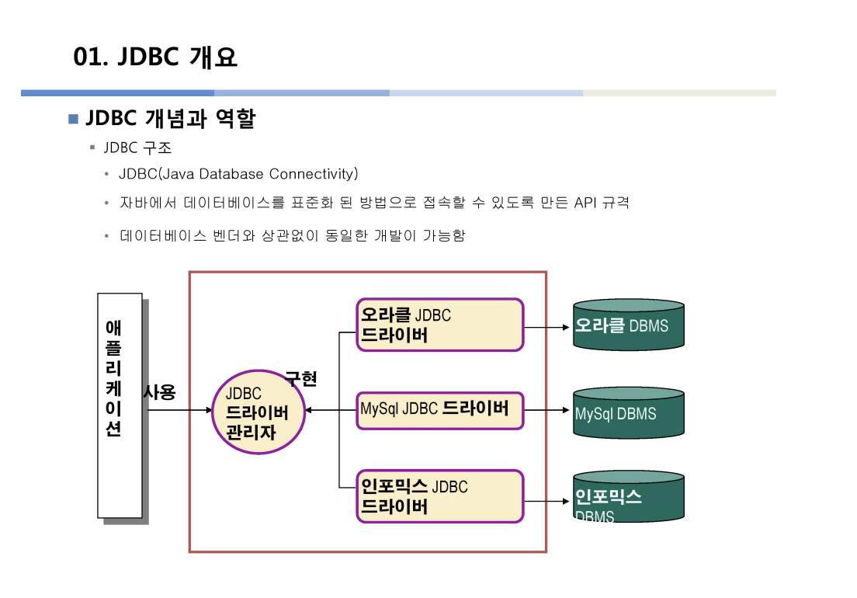
chaper 18
01
Cnnector/J 다운로드/설정

Slide 4
Part 2.
Connector/J 다운로드/설정

Slide 5
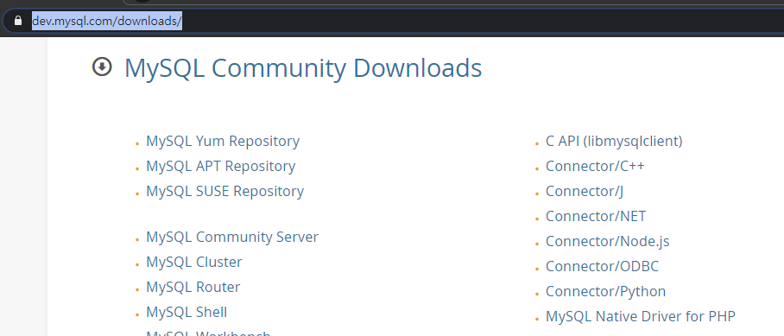
chaper 18
01
Connector/J 다운로드/설정
https://www.mysql.com/downloads/

Slide 6
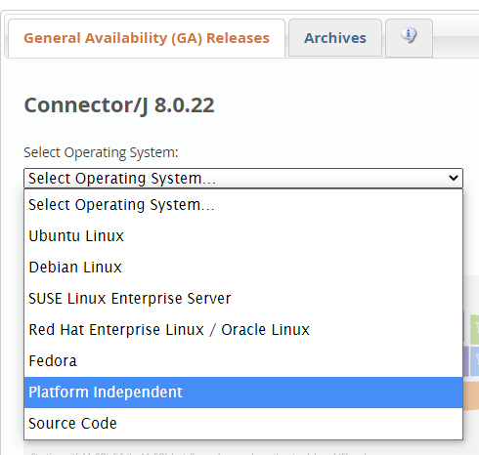
chaper 18
01
Connector/J 다운로드/설정

Slide 7
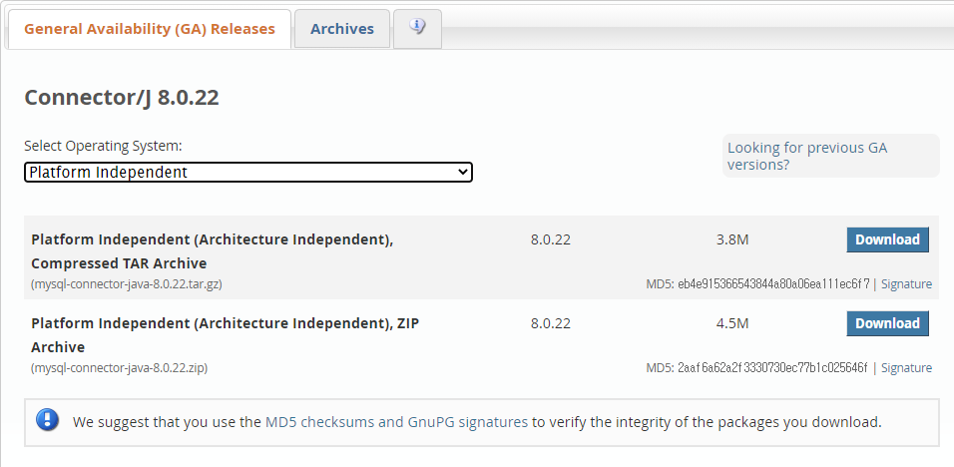
chaper 18
02
Connector/J 다운로드/설정

Slide 8
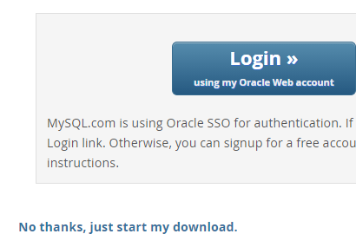
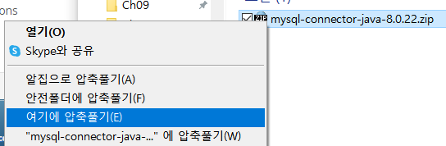
chaper 18
01
Connector/J 다운로드/설정

Slide 9
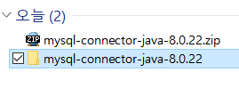
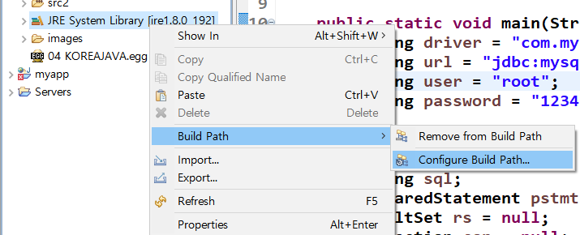
chaper 18
01
Connector/J 다운로드/설정
이클립스 왼쪽 Package Explorer ->
JRE System Library 우클릭->
Build Path->
Configure Build Path..

Slide 10
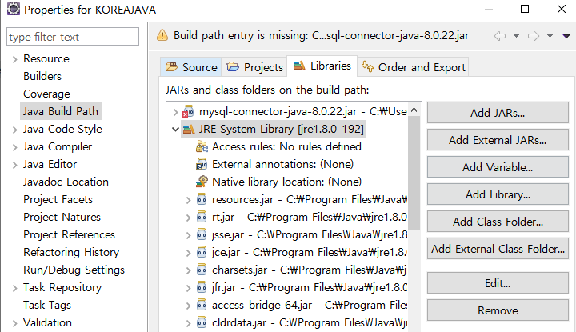
chaper 18
01
Connector/J 다운로드/설정

Slide 11
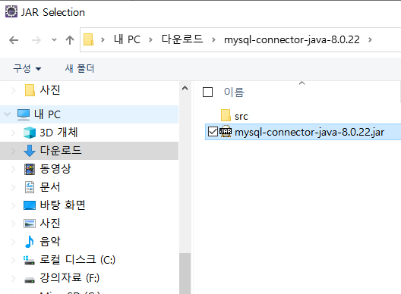
chaper 18
01
Connector/J 다운로드/설정

Slide 12
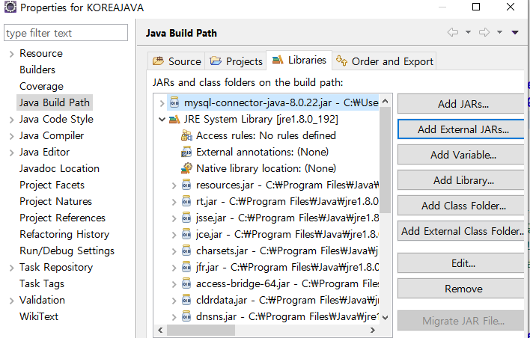
chaper 18
01
Connector/J 다운로드/설정
Apply and Close 버튼 클릭

Slide 13
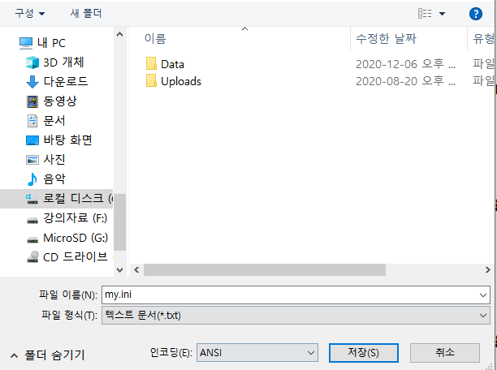
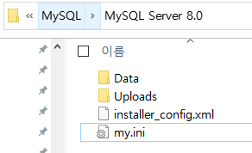

chaper 18
01
Connector/J 다운로드/설정
c:\program data\MySQL\Mysql Server 8.0
my.ini 파일 마지막에 아래 코드 추가

Slide 14
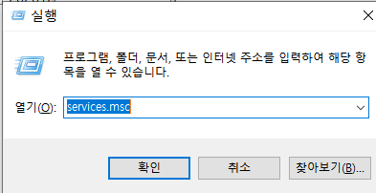
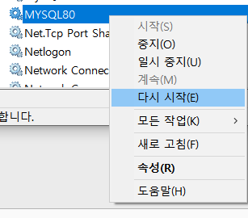
chaper 18
01
Connector/J 다운로드/설정

Slide 15
Part 3.
Mysql 연결할 DB/Table 생성

Slide 16
chaper 18
02
DB/Table 만들기
DB/Table 만들기
drop database if exists tempdb; create database tempdb; use tempdb; create table membertbl ( id char(10) primary key, name nvarchar(10) not null, age int not null, addr nvarchar(50), num1 char(6), num2 char(7), phone varchar(15) ); desc membertbl; insert into membertbl values('aaa','에이',20,'대구','888888','8888888','0102223333'); insert into membertbl values('bbb','비이',24,'울산','888883','2222222','0102827383'); select * from membertbl;

Slide 17
Part 4.
SELECT

Slide 18
chaper 18
02
SELECT Code
DB 조회
String driver = "com.mysql.cj.jdbc.Driver"; String url = "jdbc:mysql://localhost:3306/tempDB"; String user = "root"; String password = "1234"; //연결에 사용될 참조변수 String sql; //sql 문저장 PreparedStatement pstmt =null; //sql문 명령 전달하는 용도 ResultSet rs = null; //쿼리 결과 저장 Connection con = null; //연결 정보 저장 try { Class.forName(driver); System.out.println("Driver Loading Success"); con=DriverManager.getConnection(url,user,password); System.out.println("DB Connected.."); sql="select * from membertbl"; pstmt = con.prepareStatement(sql); rs=pstmt.executeQuery();

Slide 19
chaper 18
02
SELECT Code
DB 조회
while(rs.next()) { System.out.println(rs.getString("id")); System.out.println(rs.getString("name")); System.out.println(rs.getInt("age")); System.out.println(rs.getString("addr")); System.out.println(rs.getString("num1")); System.out.println(rs.getString("num2")); System.out.println(rs.getString("phone")); System.out.println(); }

Slide 20
chaper 18
02
SELECT Code
DB 조회
}catch(Exception e){ e.printStackTrace(); }finally { try { if(rs!=null) rs.close(); }catch(Exception e1) {}; try { if(pstmt!=null) pstmt.close(); }catch(Exception e2) {} try { if(con !=null) con.close(); }catch(Exception e) {} }

Slide 21
Part 5.
INSERT

Slide 22
chaper 18
02
INSERT Code
DB 삽입
String driver = "com.mysql.cj.jdbc.Driver"; String url = "jdbc:mysql://localhost:3306/tempDB"; String user = "root"; String password = "1234"; //연결에 사용될 참조변수 String sql; //sql 문저장 PreparedStatement pstmt =null; //sql문 명령 전달하는 용도 ResultSet rs = null; //쿼리 결과 저장 Connection con = null; //연결 정보 저장

Slide 23
chaper 18
02
INSERT Code
DB 삽입
try { Class.forName(driver); System.out.println("Driver Loading Success"); con=DriverManager.getConnection(url,user,password); System.out.println("DB Connected.."); sql="insert into membertbl values(?,?,?,?,?,?,?)"; pstmt = con.prepareStatement(sql); pstmt.setString(1, "ccc"); pstmt.setString(2, "씨이"); pstmt.setInt(3, 30); pstmt.setString(4, "서울"); pstmt.setString(5, "111111"); pstmt.setString(6, "2222222"); pstmt.setString(7, "0102223333"); int num = pstmt.executeUpdate(); if(num==1) { System.out.println("Insert Succeed"); }

Slide 24
chaper 18
02
INSERT Code
DB 삽입
}catch(Exception e){ e.printStackTrace(); }finally { try { if(rs!=null) rs.close(); }catch(Exception e1) {}; try { if(pstmt!=null) pstmt.close(); }catch(Exception e2) {} try { if(con !=null) con.close(); }catch(Exception e) {} }

Slide 25
Part 6.
UPDATE

Slide 26
chaper 18
02
UPDATE Code
DB 수정
String driver = "com.mysql.cj.jdbc.Driver"; String url = "jdbc:mysql://localhost:3306/tempDB"; String user = "root"; String password = "1234"; //연결에 사용될 참조변수 String sql; //sql 문저장 PreparedStatement pstmt =null; //sql문 명령 전달하는 용도 ResultSet rs = null; //쿼리 결과 저장 Connection con = null; //연결 정보 저장

Slide 27
chaper 18
02
UPDATE Code
DB 수정
try { Class.forName(driver); System.out.println("Driver Loading Success"); con=DriverManager.getConnection(url,user,password); System.out.println("DB Connected.."); sql="update membertbl set addr=? where id=?"; pstmt = con.prepareStatement(sql); pstmt.setString(1, "옥천"); pstmt.setString(2, "aaa"); int num = pstmt.executeUpdate(); if(num==1) { System.out.println("Update Succeed"); }

Slide 28
chaper 18
02
UPDATE Code
DB 수정
}catch(Exception e){ e.printStackTrace(); }finally { try { if(rs!=null) rs.close(); }catch(Exception e1) {}; try { if(pstmt!=null) pstmt.close(); }catch(Exception e2) {} try { if(con !=null) con.close(); }catch(Exception e) {} }

Slide 29
Part 7.
DELETE

Slide 30
chaper 18
02
DELETE Code
DB 삭제
String driver = "com.mysql.cj.jdbc.Driver"; String url = "jdbc:mysql://localhost:3306/tempDB"; String user = "root"; String password = "1234"; //연결에 사용될 참조변수 String sql; //sql 문저장 PreparedStatement pstmt =null; //sql문 명령 전달하는 용도 ResultSet rs = null; //쿼리 결과 저장 Connection con = null; //연결 정보 저장

Slide 31
chaper 18
02
DELETE Code
DB 삭제
try { Class.forName(driver); System.out.println("Driver Loading Success"); con=DriverManager.getConnection(url,user,password); System.out.println("DB Connected.."); sql="delete from membertbl where id=?"; pstmt = con.prepareStatement(sql); pstmt.setString(1, "aaa"); int num = pstmt.executeUpdate(); if(num==1) { System.out.println("Delete Succeed"); }

Slide 32
chaper 18
02
DELETE Code
DB 삭제
}catch(Exception e){ e.printStackTrace(); }finally { try { if(rs!=null) rs.close(); }catch(Exception e1) {}; try { if(pstmt!=null) pstmt.close(); }catch(Exception e2) {} try { if(con !=null) con.close(); }catch(Exception e) {} }

Slide 33
E N D.
고생하셨습니다

